Slide 1


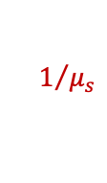
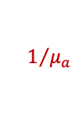
$$n_{out}$$
1
$$n_{in}$$
$$1/{μ_{a}}$$
2
3
4
$$1/{μ_{s}}$$
5

Slide 2

Set settings: EM=1 PW=0.4
Print square wall with settings
Measure Path Width
Does the path width
= 0.4 mm?
Yes
Done
No
$${EM}_{new}= {EM}_{printed} (\frac{{PW}_{desired}}{{PW}_{measured}})$$

Slide 3
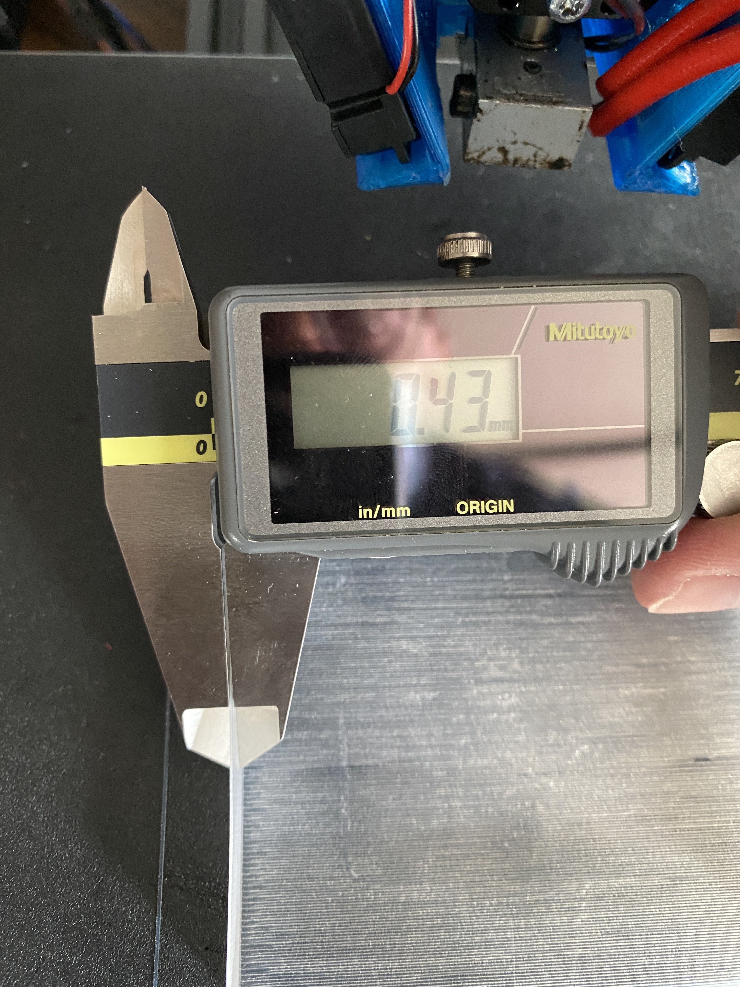

Slide 4
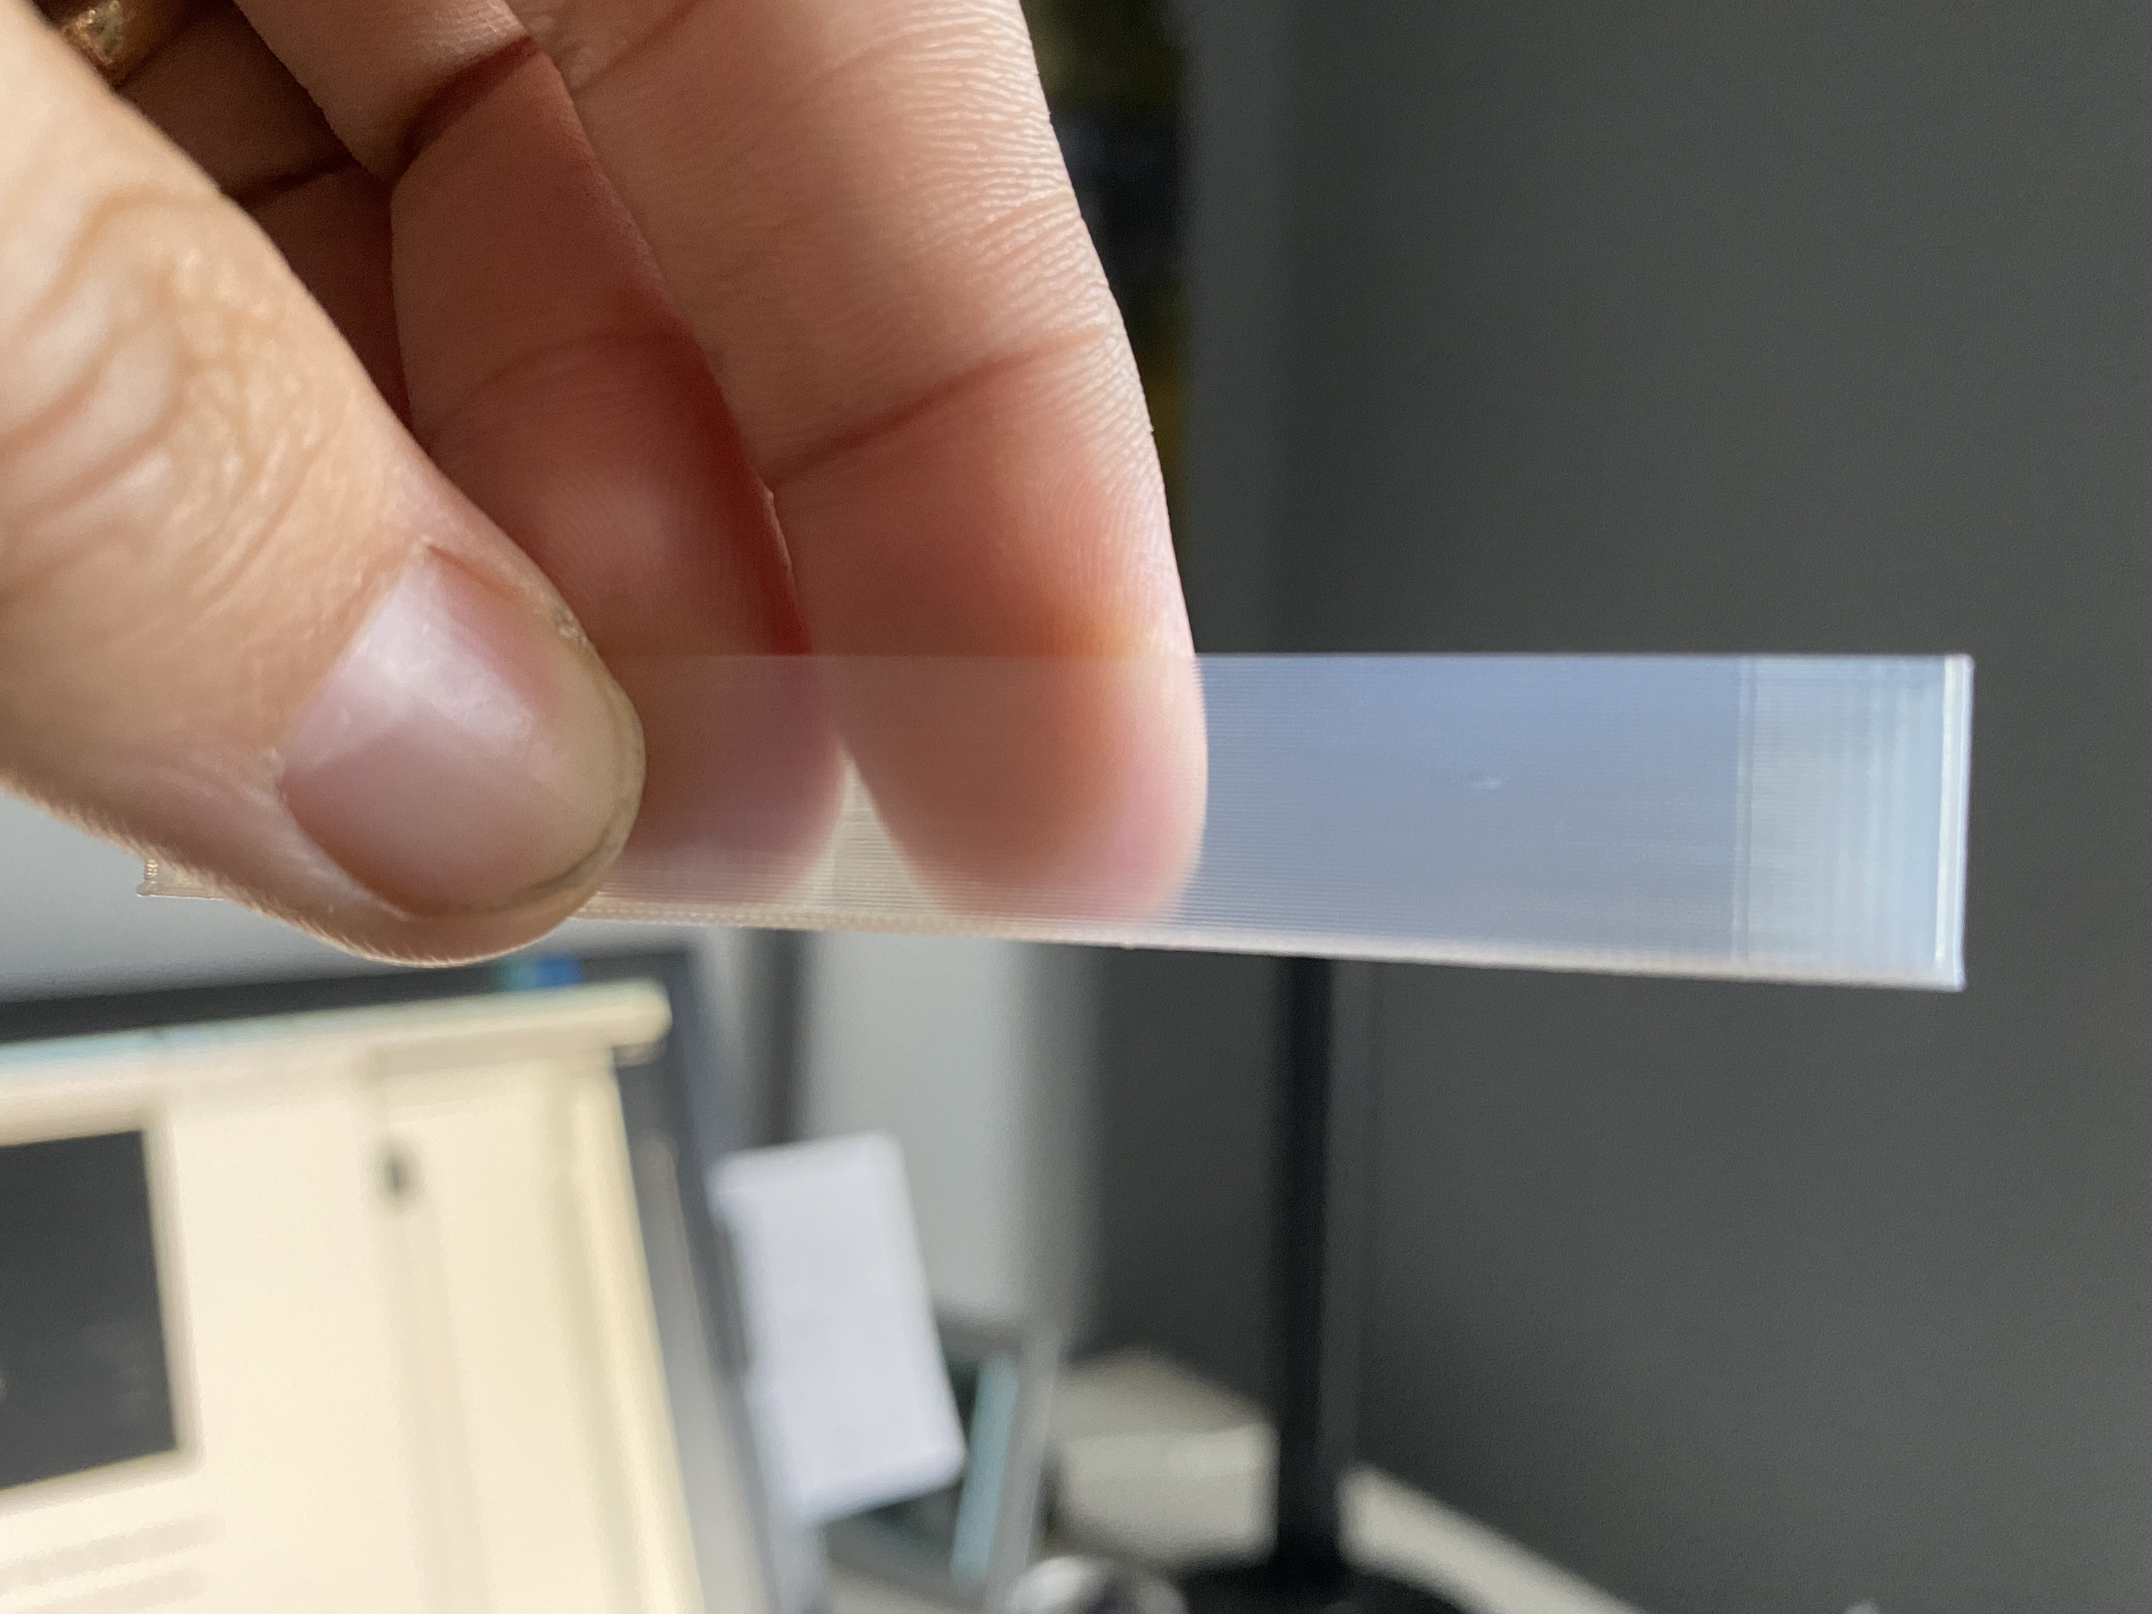

Slide 5
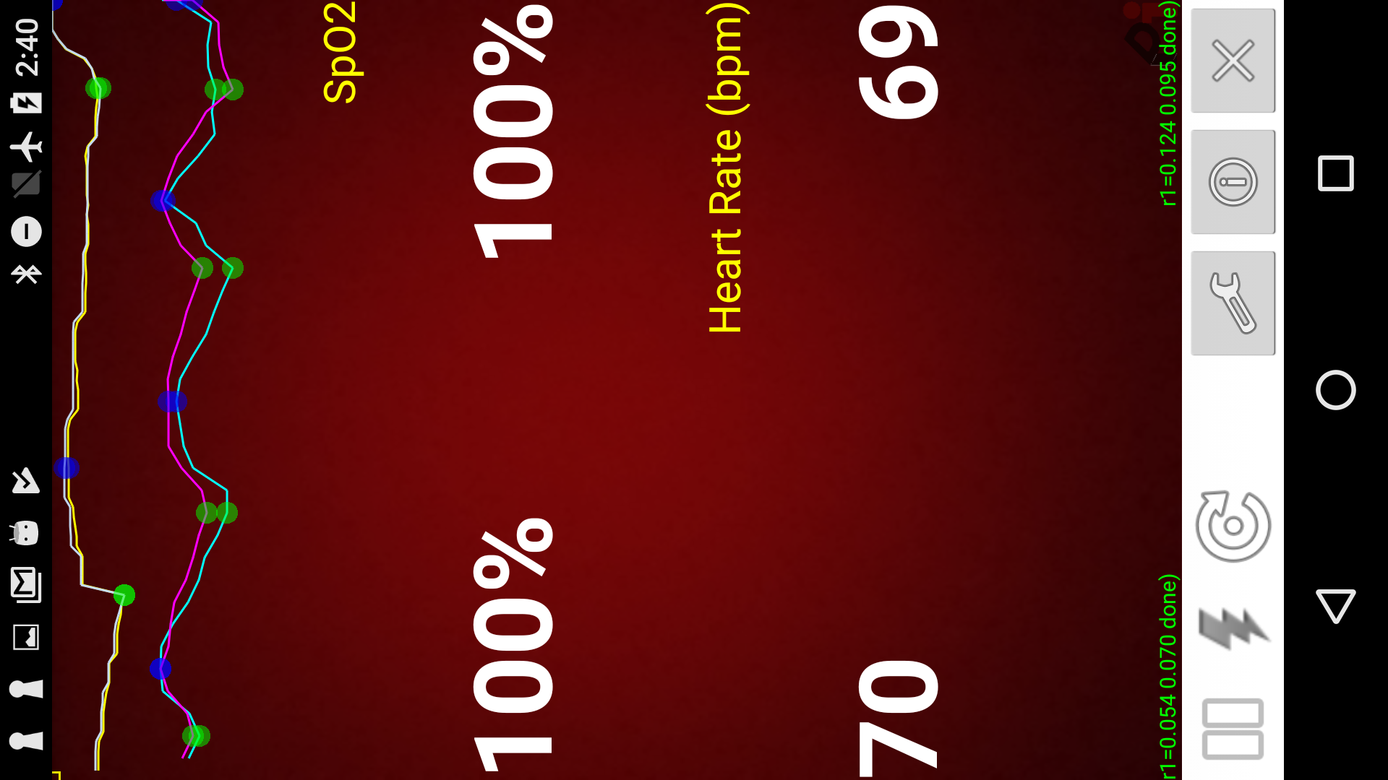

Slide 6
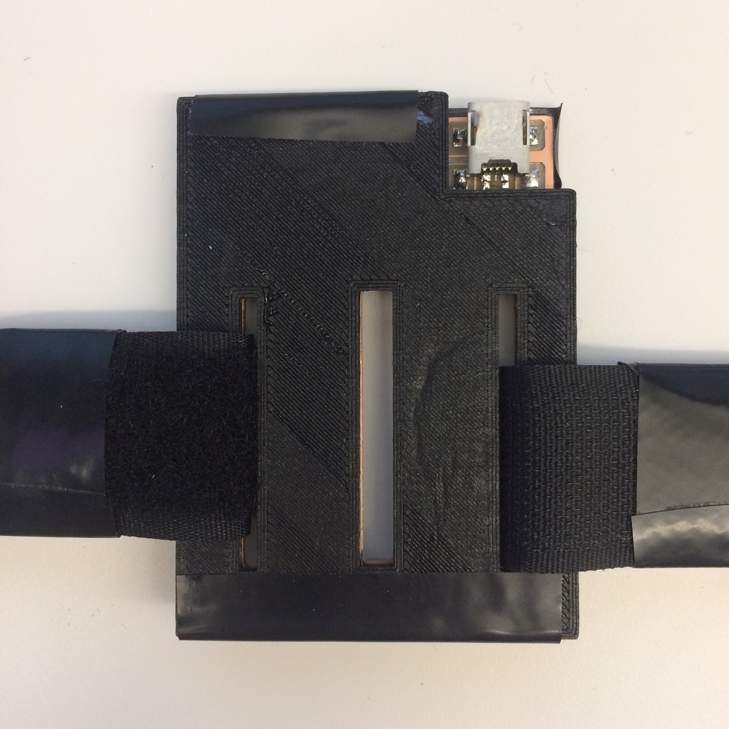

Slide 7
